Slide 1
CPE 404
Computer Hardware Design
Dr Osama Hosameldeen
Spring 2021
Lecture 5
Adders and Subtractors

Slide 2
Topics
Design of Binary Ripple Carry Adder
  Design of Half Adders
  Design of Full Adders
Design of BCD Adders
1’s and 2’s Complement
Design of Binary Subtractor
Design of Binary Adder-Subtractors
Design of Binary Multipliers
Notes:
School of Engineering

Slide 3
Binary Arithmetic Circuits

Slide 4
Recall: Arithmetic -- addition
Binary addition is similar to decimal arithmetic
Half Adder Ckt
Full Adder Ckt
No carries
1
0
1
1
0
Carries
 | 1 | 0 | 1 | 1 | 0
+ | 1 | 0 | 1 | 1 | 1
0
1
1
0
0
+
1
0
0
0
1
1 | 1 | 1 | 0 | 1
1
0
1
1
0
1
Remember:
1+1 is 2 (or (10)₂), which results in a carry
1+1+1 is 3 (or (11)₂) which also results in a carry

Slide 5
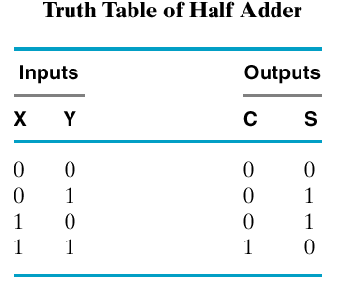
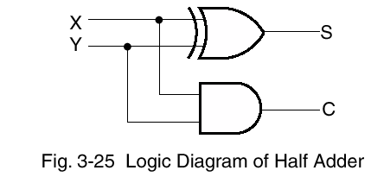
Half Adder (One bit Adder)
S = XY’ + X’Y
= X ⊕ Y
C = X.Y
Capable of adding only two
bits but no Carry in

Slide 6
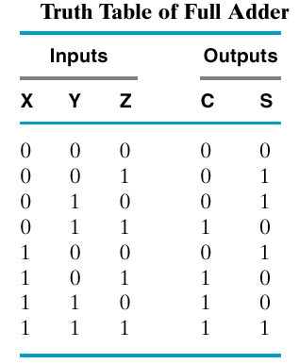
Full Adder
Capable of adding two
bits with a Carry in
x
y
Full Adder
C_{out}
Z
S
Three inputs:
  X
  Y
  Third input is C_{in} → Z
Two outputs:
  Sum
  C_{out}
Implementation?

Slide 7
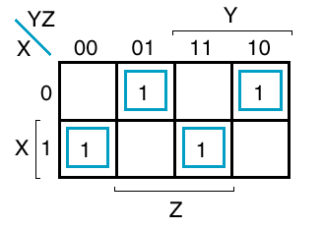
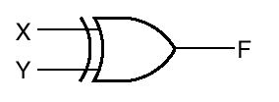

FA: Straight Forward Implementation
K Map for S
S
Z
What is this?

Slide 8
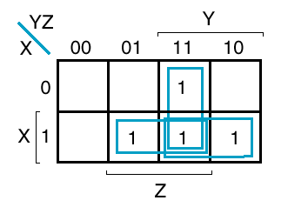
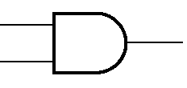
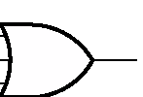
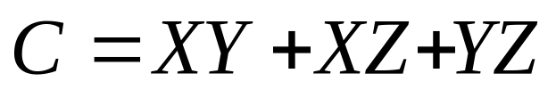
FA: Straight Forward Implementation
K Map for C
X
Y
C
X
Z
Y
Z

Slide 9
Implementation Issues
If we try to implement the Optimized Boolean functions directly we will need how many gates?
  Nine Gates: Seven AND gates and two OR Gates!!
Can we do better?
YES!!
  Share Logic
  Hierarchical Design.

Slide 10
Any Alternatives?
Try to make use of hierarchy to design a 1-bit full adder from two half adders.
Also, try to share logic between the Sum output and Carry output.
Half Adder
S = X ⊕ Y
C = XY
Full Adder
S = X ⊕ Y ⊕ Z
C = XY + XZ + YZ

Slide 11
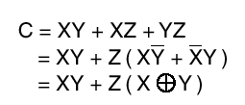
A Different Way to Represent C
XYZ
YZ
00
01
11
10
X
 |  | 1
 | 1 | 1 | 1
0
1
XY
XYZ
C = XY + XYZ + XYZ
C = XY + Z (XY + XY)

Slide 12
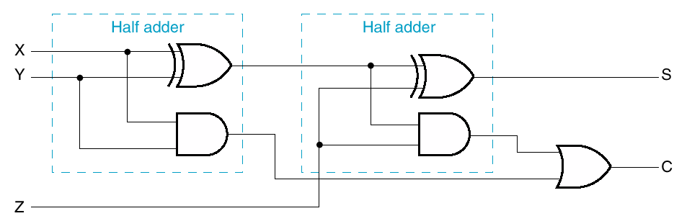
Two Half Adders (and an OR)
x
y
Full Adder
C
Z
S

Slide 13
Binary Ripple Carry Adder

Slide 14
Binary Ripple-Carry Adder
A Parallel binary adder is a digital circuit that produces the arithmetic sum of two binary numbers using only combinational logic.
The parallel adder uses “n” full adders in parallel, with all input bits applied simultaneously to produce the sum.
The full adders are connected in cascade, with the carry output from one full adder connected to the carry input of the next full adder.

Slide 15
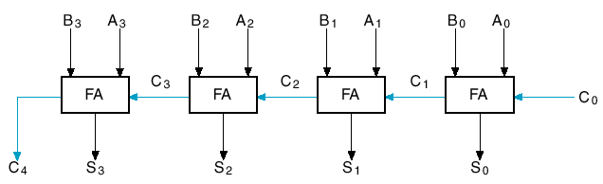
Binary Ripple-Carry Adder
Straightforward – connect full adders
Carry-out to carry-in chain
  C₀ in case this is part of larger chain, maybe just set to zero

Slide 16
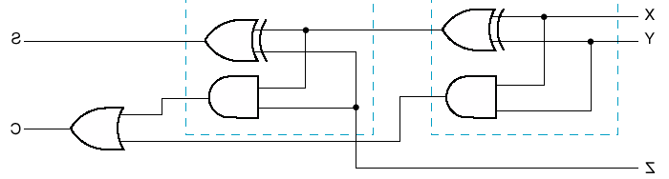
Any Problems with this Design?
Delay
  Approx how much?
Imagine a 64-bit adder
  Look at carry chain

Slide 17
Carry Propagation & Delay
One problem with the addition of binary numbers is the length of time to propagate the ripple carry from the least significant bit to the most significant bit.
The gate-level propagation path for a 4-bit ripple carry adder of the last example:
Note: The "long path" is from A₀ or B₀ through the circuit to S₃.
A₃
A₂
A₁
A₀
B₃
B₂
B₁
B₀
C₃
C₂
C₁
C₀
C₄
S₃
S₂
S₁
S₀

Slide 18
Binary Coded Decimal (BCD)

Slide 19
Recall: Binary Coded Decimal
Decimal | BCD
0 | 0 0 0 0
1 | 0 0 0 1
2 | 0 0 1 0
3 | 0 0 1 1
4 | 0 1 0 0
5 | 0 1 0 1
6 | 0 1 1 0
7 | 0 1 1 1
8 | 1 0 0 0
9 | 1 0 0 1
Binary Coded Decimal (BCD)
  Each Decimal Digit is represented
  by 4 bits
  (0 – 9) ⇨ Valid combinations
  (10 – 15) ⇨ Invalid combinations

Slide 20
BCD Addition
One decimal digit + one decimal digit
  If the result is a single decimal digit ( ≤ 9 ), then it is a simple binary addition
  Example:
  If the result is two decimal digits ( ≥ 10 ), then binary addition gives invalid combinations
  Example:
5
+ 3
8
0 1 0 1
+ 0 0 1 1
1 0 0 0
5
+ 5
1 0
0 1 0 1
+ 0 1 0 1
1 0 1 0
0 0 0 1 0 0 0 0

Slide 21
BCD Addition
If the binary result
is greater than 9,
correct the result by
adding a “6”
5
+ 5
1 0
0 1 0 1
+ 0 1 0 1
1 0 1 0
+ 0 1 1 0
0 0 0 1 0 0 0 0
Multiple Decimal Digits
3 5 1
Two Decimal Digits
0 0 1 1
0 1 0 1
0 0 0 1
Notes:
Four binary digits count up to 15 (1111) but in BCD we only use the representations up to 9 (1001). The difference between 15 and 9 is 6. If you want 9+1 to produce 10, which is 1 0000, you have to add 6 to make 1010 wrap to 1 0000.
It is done to skip the six invalid states of binary coded decimal i.e from 10 to 15 and again return to the BCD codes.
School of Engineering

Slide 22
BCD Addition: Why add “6”?
Four binary digits count up to 15 (1111) but in BCD we only use the representations up to 9 (1001).
It is done to skip the six invalid states of binary coded decimal i.e from 10 to 15 and again return to the BCD codes.
The difference between 15 and 9 is 6. If you want 9+1 to produce 10, which is 1 0000, you have to add 6 to make 1010 wrap to 1 0000.

Slide 23
BCD Arithmetic
8
1000
Eight
+5
+0101
Plus Five
13
1101
is 13 (> 9)
Note that the result is greater than 9!!
  So a correction has to be performed
To correct the digit, add 6
8
1000
Eight
+5
+0101
Plus 5
13
1101
is 13 (> 9)
+0110
so add 6
carry = 1
0011
leaving 3 + cy
0001 | 0011
Final answer (two digits)

Slide 24
BCD Addition Circuit
Design a BCD Adder that adds two BCD digits.
Constraints:
  Use 4-bit Binary Adders
Hints:
  A detection circuit that detects invalid BCD digits will need to be designed.
Notes:
School of Engineering

Slide 25
BCD Addition
BCD # 1
BCD # 2
Addend
Augend
4-bit binary adder
Input
Carry
Detection
Circuit for
Invalid BCD
Output
Carry
0 or 6
Add 0 if result is valid
Add 6 if result is invalid
4-bit binary adder
BCD Sum

Slide 26
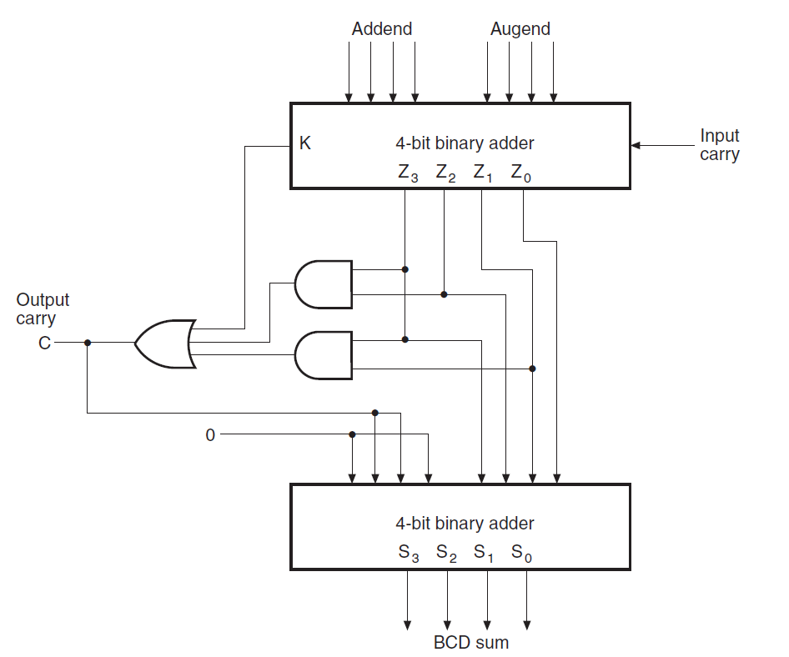
BCD Addition
Z₃ Z₂ Z₁ Z₀
1 | 0 | 1 | 0
1 | 0 | 1 | 1
1 | 1 | 0 | 0
1 | 1 | 0 | 1
1 | 1 | 1 | 0
1 | 1 | 1 | 1

Slide 27
Binary Subtraction

Slide 28
Binary Subtraction
Borrow a “Base” when needed
1
2
= (10)₂
0
2
2
0
0
2
1
0
0
1
1
0
1
= (77) ₁₀
= (23) ₁₀
−
1
0
1
1
1
0
1
1
0
1
1
0
= (54) ₁₀

Slide 29
Subtraction
We managed to design an Adder easily.
For subtraction, we will also need to design a Subtractor!!
Can we perform subtraction by reusing the adder circuit we designed earlier?
YES, we can use the concept of Complements.
  X = Y – Z ➔ X = Y + complement(Z)

Slide 30
Subtraction via Complements

Slide 31
Complements?
There are two types of complements for each base-r system
  The radix complement, the (r’s) complement.
  The diminished radix complement, (r-1)’s comp.
For Decimal System
  10’s complement
  9’s complement
For Binary Systems
  2’s complement
  1’s complement

Slide 32
Complements of Decimal System
The 9’s complement of a decimal number is obtained by subtracting each digit from 9.
  Example: The 9’s complement of 546700 is
  999999 – 546700 = 453299
The 10’s complement is obtained by adding 1 to the 9’s complement:
  Example: The 10’s complement of 546700 is
  999999 – 546700 = 453299 + 1 = 453300
  Or, 1000000 – 546700 = 453300
  Or, leave all least significant 0’s unchanged, subtract the first nonzero LSD from 10, and subtract all higher significant digits from 9.

Slide 33
Unsigned Decimal Subtraction
Example #1
  72532 – 3250 = 69282
Use 10’s complement to perform the subtraction
M = 72532 (5-digits), N = 3250 (4-digits)
  Since N has only 4 digits append a zero N=03250
  What is the 10’s complement of N (03250) ?
    99999 – 03250 = 96749 + 1 = 96750
  Now add M to the 10’s comp of N
    72532 + 96750 = 169282 (carry occurred)
  The occurrence of the end carry indicates that M > N
  Discard end carry (169282 – 100000 = 69282)

Slide 34
Unsigned Decimal Subtraction
Example #2
3250 - 72532 = - 69282 (HOW??)
Compare the numbers, exchange their positions, …
Use 10’s complement to perform the subtraction
M = 3250 (4-digits), N = 72532 (5-digits)
  Since M has only 4 digits append a zero M=03250
  What is the 10’s complement of N (72532)?
    99999 – 72532 = 27467 + 1 = 27468
  Now add M to the 10’s comp of N
    03250 + 27468 = 30718 (There is no end carry!)
  No end carry indicates that M < N (make correction!!)
  Answer: -(10’s complement of 30718) = -69282

Slide 35
Binary Unsigned Subtraction
We’ll use unsigned subtraction to motivate use of complemented representation

Slide 36
1’s Complement

Slide 37
1’s Complement
1’s Complement (Diminished Radix Complement)
  All ‘0’s become ‘1’s
  All ‘1’s become ‘0’s
  Example (10110000)₂
  ⇨ (01001111)₂
  If you add a number and its 1’s complement …???
1 0 1 1 0 0 0 0
+ 0 1 0 0 1 1 1 1
1 1 1 1 1 1 1 1
Zero in 1’s complement!!

Slide 38
1’s Complement: Example
1 0 1 0 1 0 1 0
0 1 0 1 0 1 0 1
Notice that the 1’s complement of the number 10101010 can be obtained by complementing each bit
2^{n} - 1 | 1 | 1 | 1 | 1 | 1 | 1 | 1
- N | 0 | 1 | 0 | 1 | 0 | 1 | 0
1’s Compl. | 1 | 0 | 1 | 0 | 1 | 0 | 1

Slide 39
2’s Complement

Slide 40
2’s Complement
2’s Complement (Radix Complement)
  Take 1’s complement then add 1
  Toggle all bits to the left of the first ‘1’ from the right
  Example:
  Number:
  1’s Comp.:
OR
1 0 1 1 0 0 0 0
0 1 0 0 1 1 1 1
+ 1
1 0 1 1 0 0 0 0
0 1 0 1 0 0 0 0
0
1
0
1
0
0
0
0

Slide 41
2’s Complement: Example
2^{n} | 1 | 0 | 0 | 0 | 0 | 0 | 0
- N |  | 0 | 1 | 1 | 0 | 0 | 1
1’s Comp |  | 1 | 0 | 0 | 1 | 1 | 0
2’s Compl. |  | 1 | 0 | 0 | 1 | 1 | 1
Notice that the 2’s complement of the number 011001 can be obtained by complementing each bit and adding 1.

Slide 42
Example: Incorrect Result
Notice that Minuend is smaller than Subtrahend
19 – 30 = 21 !!!!!
Borrow | 1 | 1 | 1 | 0 | 0
(M) Minuend | 1 | 0 | 0 | 1 | 1
(N) Subtrahend - | 1 | 1 | 1 | 1 | 0
Difference | 1 | 0 | 1 | 0 | 1
19
30
21
Incorrect Result!!
How can we know if the result is incorrect? How to fix the problem?

Slide 43
Example
If no borrow, then result is non-negative (minuend >= subtrahend).
Borrow | 1 | 1 | 1 | 0 | 0
(M) Minuend | 1 | 0 | 0 | 1 | 1
(N) Subtrahend - | 1 | 1 | 1 | 1 | 0
Difference | 1 | 0 | 1 | 0 | 1
Since there is borrow, result must be negative.
The result must be corrected to a negative number.
19 – 30 = -11
Correct Diff - | 0 | 1 | 0 | 1 | 1
2’s complement of 1 0 1 0 1 → 0 1 0 1 1
Procedure?

Slide 44
Subtraction: Algorithm #1

Slide 45
Algorithm: Subtraction of two n-digit Numbers M-N can be done as follows
Subtract N from M
  If no borrow, then M ≥ N and result is OK
  Else, if a borrow occurs → N > M so result must be subtracted from 2^{n} and a minus sign should be appended
NOTE that the subtraction of a binary number from 2^{n} to obtain an n-digit result is called 2’s complement
Circuit?

Slide 46
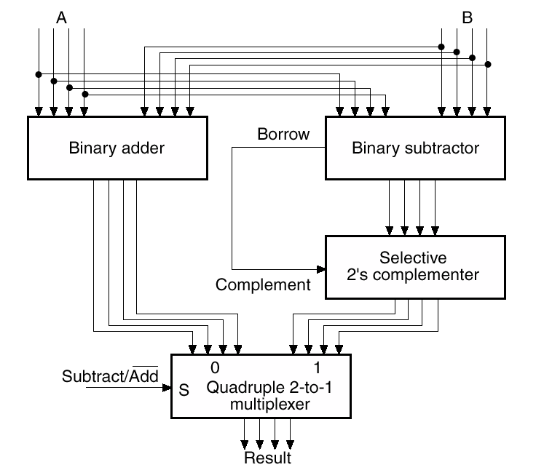
Adder/Subtractor Circuit!!
Binary Adder
Binary Subtractor
EXPENSIVE!!

Slide 47
Subtraction: Algorithm #2

Slide 48
How to get rid of Subtraction Operation?
Any
Idea?
Use complements of numbers to replace the subtraction operation with addition only.

Slide 49
Subtraction of Unsigned Numbers Using Complements
M – N Equivalent to M + (2’s complement of N)
Add (2’s complement of N) to M
  This is M + (2^{n} – N) = M – N + 2^{n}
  Notice we are using addition to achieve subtraction.
If M ≥ N, will generate carry!
  Result is correct → Simply discard carry
  Result is positive M - N
If M < N, no end carry will be generated!
  Make Correction → Take 2’s complement of result
  Place minus sign in front

Slide 50
Example
X = 1010100 minus Y = 1000011
Notice that X > Y
The 2’s complement of Y=1000011 is obtained first by getting the 1’s complement → 0111100 and then adding 1 → (0111101)
X |  | 1 | 0 | 1 | 0 | 1 | 0 | 0
+ 2’s comp Y |  | 0 | 1 | 1 | 1 | 1 | 0 | 1
Sum | 1 | 0 | 0 | 1 | 0 | 0 | 0 | 1

Slide 51
Example 2
Y = 1000011 minus X = 1010100
Notice Y < X
No end carry
Answer: - (2’s complement of Sum)
- 0010001
Y |  | 1 | 0 | 0 | 0 | 0 | 1 | 1
+ 2’s comp X |  | 0 | 1 | 0 | 1 | 1 | 0 | 0
Sum |  | 1 | 1 | 0 | 1 | 1 | 1 | 1
We said numbers are unsigned. What does this mean?

Slide 52
Adder/Subtractor Circuit

Slide 53
Adder-Subtractor
By using 2’s complement approach we were able to get rid of the design of a subtractor.
Need only adder and complementer for input to subtract
Need selective complementer to make negative output back from 2’s complement
How can we design a selective complementer?

Slide 54
Adder and Subtractor Circuits
Adder
A + 2’s complement of B = A-B
B₃
B₂
B₁
B₀
Subtractor
1
How to design an Adder/Subtractor with the same circuit?

Slide 55
Selective Complimentor
B₁
B₁
B₀
B₀
Control
MUX
MUX
0
1
S₀
S₀
S
A₁
A₀
C₂
FA
C₁
FA
C₀
S₁
S₀

Slide 56

Selective 1’s Complementer?
Control
0
1
When X = 0 we transfer Y to output
When X = 1 we complement Y
Control

Slide 57
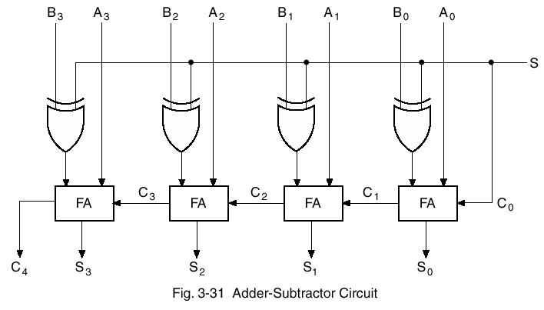
Design
S | B | In
0 | 0 | 0
0 | 1 | 1
1 | 0 | 1
1 | 1 | 0
Subtraction of Unsigned Numbers Using Complements
S low for add,
high for subtract
0
1
Inverts each bit of B if S is 1
Adds 1 to make 2’s complement
Selective 2’s Complementor

Slide 58
Lecture End

